Slide 1
Foundations of Data Science & Analytics (DSCI 633, Fall 2022)
Nidhi Rastogi
Assistant Professor, GCCIS
Rochester Institute of Technology
August 25, 2022

Slide 2
Instructor Introduction
Ph.D. in Computer Science, Rensselaer Polytechnic Institute
M.S. in Computer Science, University of Cincinnati
Bachelors in Information Technology , Delhi University, India
Worked at GE Global Research, Verizon in Engineering & Research positions
Interned at Yahoo, IBM Zurich, BBN Raytheon, GE Global Research
Research Interests - Machine learning, Graphs, Security, Autonomous Vehicles, Large distributed networks…

Slide 3

TA Introduction
Addl Tariq
MS Data Science, 2nd Year
TA Hours, email on class GitHub webpage
Also available outside of office hours
Only by appointment – contact on slack or email

Slide 4
Course Information
GitHub link - https://github.com/aiforsec/RIT-DSCI-633-FDS

Slide 5

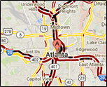
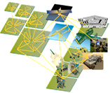


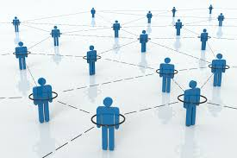
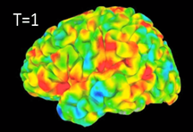
Data Mining is Everywhere
Cybersecurity
Traffic Patterns
Analyzing Sensor Data
E-Commerce
Social Networks
Brain Activity

Slide 6
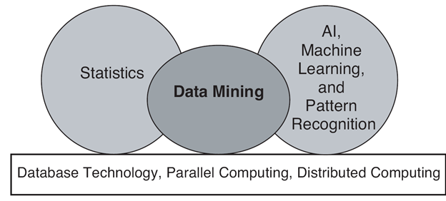
Origin of Data Mining
Especially for data:
Large-scale
High dimensional
Complex
Distributed

Slide 7


Why the Trend (Why now?)
Lot of data is being collected and warehoused
Amazon handles millions of visits/day
Google has Peta Bytes of web data
Facebook has billions of monthly active users
Computation has become cheaper & more powerful

Slide 8
Data Mining
What is
Certain names are more prevalent in certain US locations (O’Brien, O’Rourke, O’Reilly… in Boston area)
Predict whether user want information on Amazon rainforest or Amazon.com when searching for “Amazon”
What is NOT
Look up phone number in phone directory
Query a Web search engine for information about “Amazon”

Slide 9
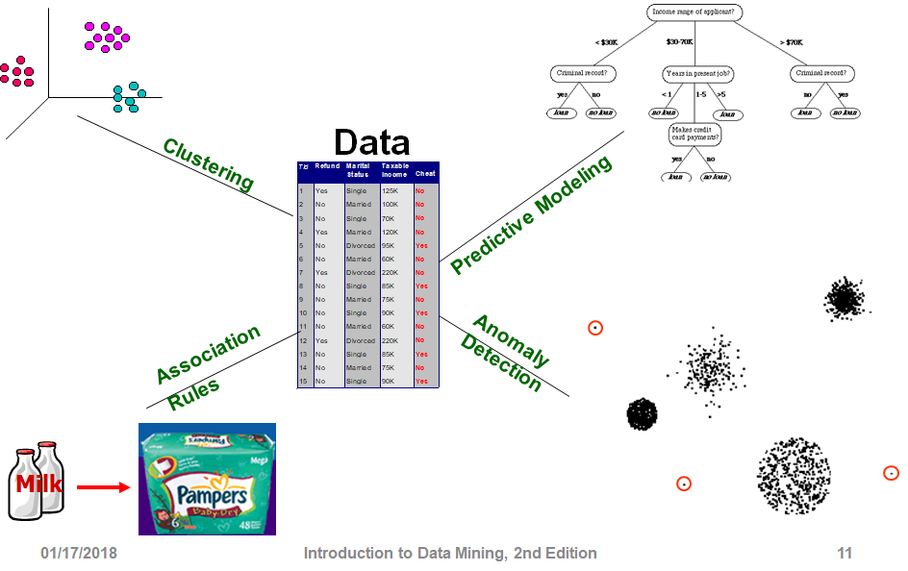
Tasks
Notes:
predict future events or outcomes by analyzing patterns in a given set of input data

Slide 10
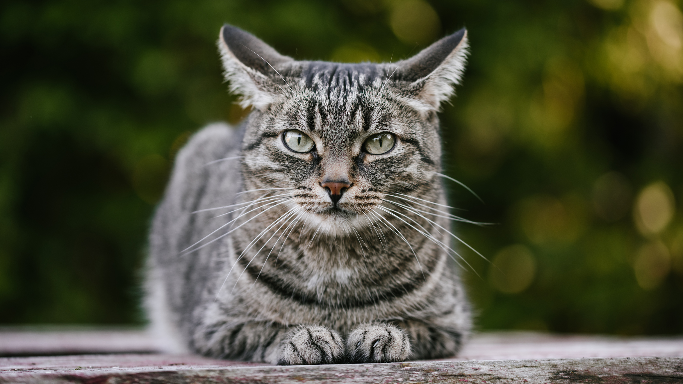
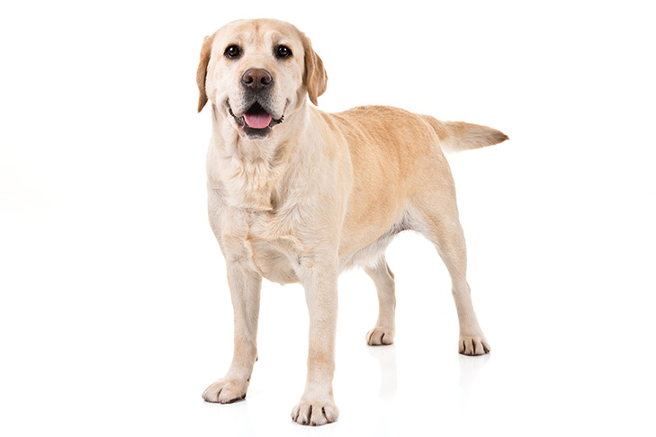
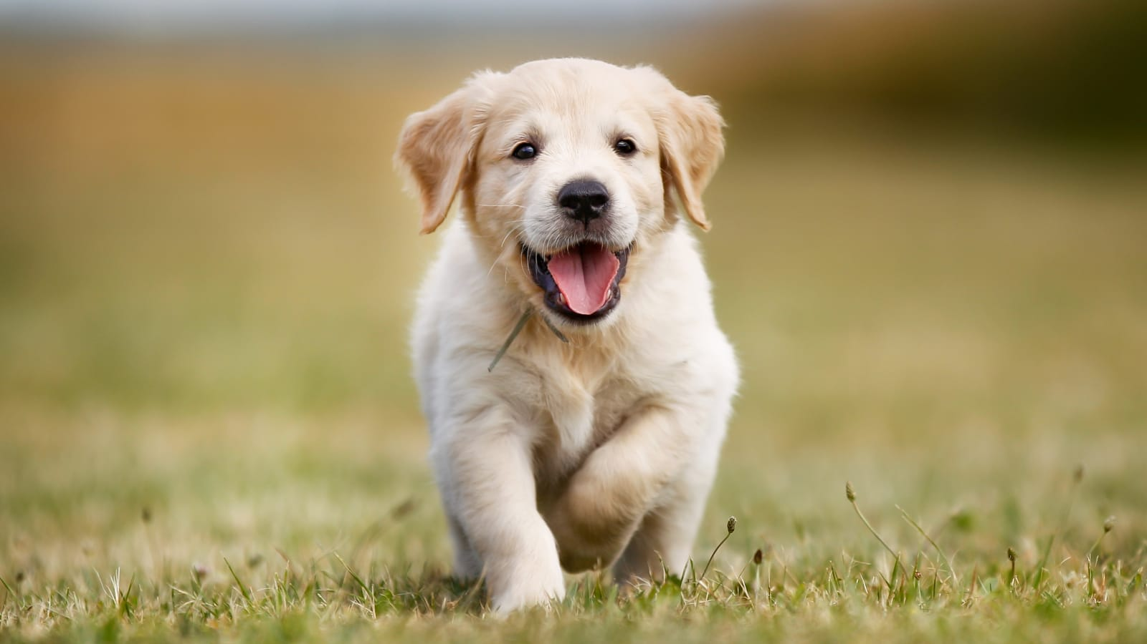
Predictive Modeling (supervised learning)
Independent Variable (Input)
Dependent Variable (Output)
Cat
Train:
Dog
Predict:
?

Slide 11
Predictive Modeling
Output
Classification:
Regression:
Classes / Categories
Continuous Numbers

Slide 12
Predictive Modeling: Classification
Image Classification
Cat
Dog
Bird
Pig
Lion
...

Slide 13
Predictive Modeling: Classification
Sentiment Analysis (NLP)
You have been working on this for months.
I need to see your results, now!
Positive
Neutral
Negative

Slide 14
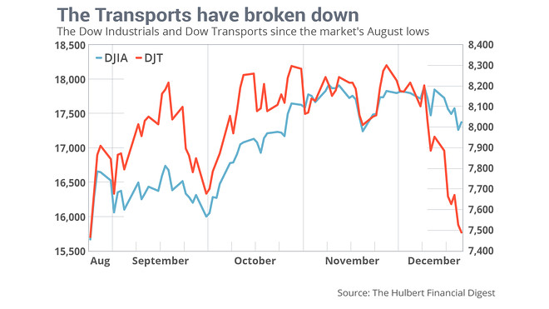
Predictive Modeling: Regression
Time Series Analysis
Dow Jones Industrial Average (DJIA)
and Dow Jones Transportation Average (DJT) for January?

Slide 15
Predictive Modeling: Regression
ID | Name | Gender | GRE | Coding
001 | Emily Wang | F | 320 | Yes
002 | James Bond | M | 320 | Yes
Problem?
Bias
Score in Foundation of Data Science

Slide 16
Tasks

Slide 17
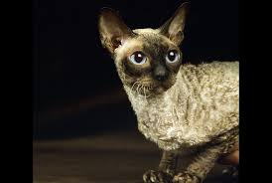
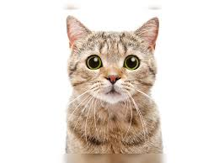
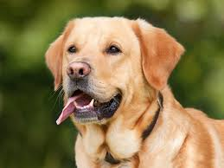
Clustering (unsupervised learning)
Independent Variable

Slide 18
Clustering (unsupervised learning)
Independent Variable

Slide 19
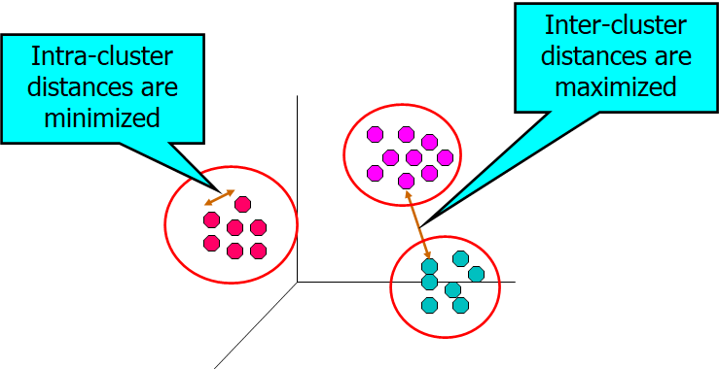
Clustering (objectives)

Slide 20
Clustering (applications)
User ID | Titanic | Die Hard | Avatar
001 | Yes | Yes | No
002 | Yes | No | Yes
Groups of users that like similar movies

Slide 21
Clustering (applications)
Topic Modeling
Area soccer players earn all-state selections.
Sports | Politics | News | Movie
0.4 | 0.18 | 0.4 | 0.02

Slide 22
Tasks

Slide 23
Association Rule Learning
User ID | Titanic | Die Hard | Avatar
001 | Yes | Yes | Yes
002 | Yes | No | Yes
People who watched Titanic will also watch Avatar

Slide 24
Tasks

Slide 25
Anomaly Detection
Purchase | 11/03/2019 | 11/13/2019 | 11/23/2019 | 12/03/2019 | 12/04/2019
001 | Titanic | Avatar | Die Hard | Aliens | Hunter X Hunter

Slide 26
Preparation for HomeWorks and Project
Create GitHub account
Star : https://github.com/aiforsec/RIT-DSCI-633-FDS
4. Slack Channel for the course

Slide 27
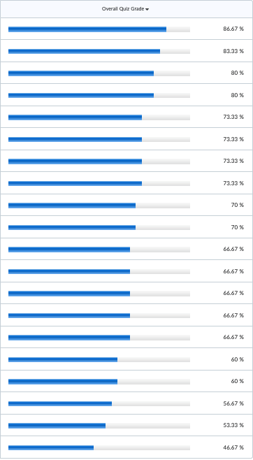
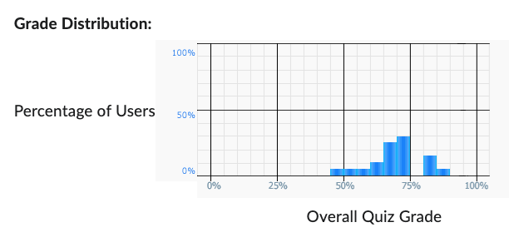
Python Quiz – Class Performance
Class Average: 68.67%

Slide 28
Questions

